Slide 1


MSA University
Faculty of Engineering
ECE552 Mobile Communication Systems
Chapter 2 Principles of Wireless Communication Systems (Cont.)
Prof. Fawzy Ibrahim
Dr. Abdelrahman El-Akhdar
Assoc. Prof. Nariman Abdelsalam
Electronics and Communication Department
October University for Modern Sciences and Arts (MSA)

Slide 2
Chapter Contents
Chapter 2 Principles of wireless communications (cont.)
2.1 Electromagnetic Wave Channel Impairments
2.1.1 Attenuation or Free Space Loss
2.1.2 Large-scale fading (shadowing)
2.1.3 Small-scale fading (multipath)
2.1.4 Doppler Shift
2.2 Propagation Modeling in Cellular Systems
1.Line of Site 2. Ground wave propagation 3. Sky wave propagation
2.3 Fading Mitigation Techniques
1. Diversity (time, freq., space) 2. Equalization
2.4 Channel Propagation Models
2.4.1 Free Space Path Loss 2.4.2 Mobile Environment Model
2.4.3 Empirical Models 2.4.4 Statistical Models
2.5 Multiple Access Techniques
1. TDMA 2. FDMA 3. CDMA
2.6 Mobile system network Architecture
2.6.1 Mobile Network Structure
2.6.2 Mobile Communication Site
2.6.3 Mobile Industry Companies
2.7 Mobile History or Generations
2.7.1 First Generation (1G)
2.7.2 Second Generation (2G)
2.7.3 Third Generation (3G)
2.7.4 Fourth Generation (4G)
2.7.5 Fifth Generation (5G)

Slide 3
2.1 Electromagnetic Wave Channel Impairments
The wireless transmission path between a sender and a receiver varies from simple Line Of Site (LOS) to one that is severely obstructed by buildings, mountains, etc.
Most cellular systems operate in urban area where there is no LOS path between transmitter and receiver as shown in Fig. 1.26.
Even speed of motion effects the fading characteristics of the channel
2.1.1 Attenuation or Free Space Loss
Strength of signal falls off with distance over transmission medium as shown in Fig. 1.27. It is deterministic degradation of power.
2.1.2 Large-scale fading (shadowing)
Long term variation in the mean signal level caused by the mobile unit moving into the shadow of surrounding objects such as hills or manmade structures, (buildings, Elevators or tunnels). It is random variation of power over distance.
The measured signal power differ substantially at different locations even though at the same radial distance from a transmitter as shown in Fig. 1.27.
Power Problems as in Fig. 1.27
Free Space Loss
Large-scale fading
(shadowing)
Small-scale fading
(multipath)

Slide 4
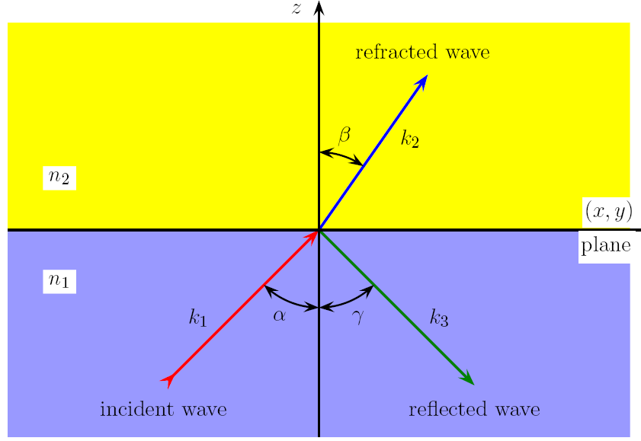
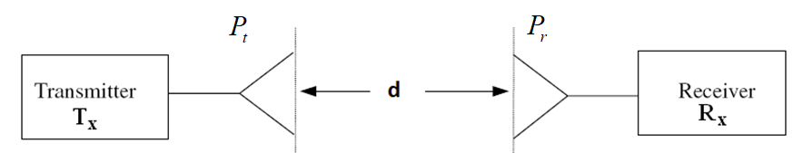
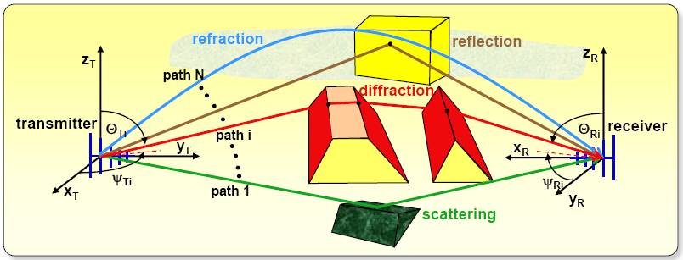
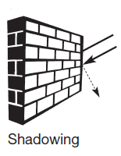
2.1 Electromagnetic Wave Chanel Impairments
(a) Free Space Loss (LOS).
Refraction
(b) Large-scale
fading
(shadowing)
(b) Small-scale fading
Fig. 1.26 Electromagnetic wave impairments.

Slide 5
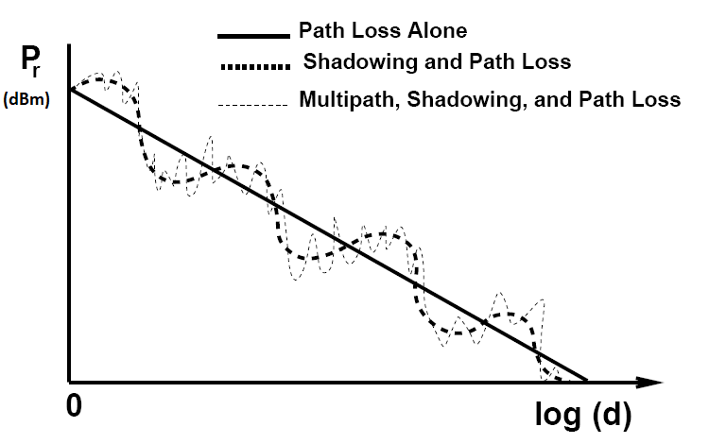
2.1 Electromagnetic Wave Channel Impairments
2.1.2 Large-scale fading (shadowing)
Represents the medium scale fluctuations of the radio signal strength over distances from tens to hundreds of meters d >> λ.
Fig. 1.27 Illustration of Path Loss, Shadowing and Multipath Fading.

Slide 6
2.1 Electromagnetic Wave Channel Impairments
2.1.2 Large-scale fading (shadowing)
The Large-scale fading due to:
Shadowing
It is an extreme form of attenuation or blocking of radio signals due to large obstacles. The higher the frequency of a signal, the more it behaves like light. Even small obstacles like a simple wall, a truck on the street, or trees in an alley may block the signal.
2.1.3 Small-scale fading (multipath)
Small-scale fading is used to describe the rapid fluctuations of the amplitudes, phases, or multipath delays of a radio signal over a short period of time or distance. It is caused by interference between two or more versions of the transmitted signal (called multipath waves) which arrive at the receiver at slightly different times.
Multipath waves combine at the receiver antenna to give a resultant signal which can vary widely in amplitude and phase from transmitted signal as in Fig. 1.26. This is due to:
1. Reflection
Reflection occurs when an electromagnetic wave falls on an object, which has very large dimensions as compared to the wavelength of the propagating wave.

Slide 7
2.1 Electromagnetic Wave Chanel Impairments
2.1.3 Small-scale fading (multipath)
1. Reflection occurs due to:
- Perfect conductors reflect with no attenuation.
- Dielectrics reflect a fraction of incident energy.
2. Diffraction
It occurs when the radio signal path is obstructed by a surface that has sharp irregularities / edges. This results in a bending of waves around the obstacle
3. Scattering
Occurs when the radio channel contains objects whose sizes are on the order of the wavelength or less of the propagating wave and also when the number of obstacles are quite large. It causes the transmitter energy to be radiated in many directions. Lamp posts and street signs may cause scattering.
4. Refraction
When an electromagnetic wave hits a boundary between different materials, some of the wave's energy is reflected back while the rest continues on through the second material, although the direction of the continuing wave may be somewhat different from the original wave's; this bending of the wave's direction is called the refraction.

Slide 8
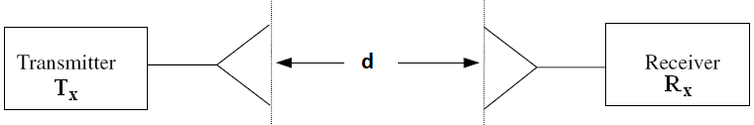
2.2 Propagation Modeling in Cellular Systems
2.2.1 Line of Site or Free Space Path Loss Model
It is used to predict signal strength when transmitter and receiver have clear unobstructed LOS path. Satellite communications and LOS microwave link systems have this kind of propagation.
This model predicts that signal decays as a function of the Transmitter-Receiver separation distance, d. The equation used is the Friis free space equation. For LOS, Free Space Path Loss (FSPL), is calculated as follows:
1. Consider a simplified communication link as illustrated in Fig. 1.28. A distance, d separates the Transmitter (Tx) and the Receiver (Rx). If power input to the transmitting antenna is P_{t}, and a directional transmitting antenna gain of G_{t}, the isotropic power density P_{d} at a distance d from the antenna is given by:
The antenna gain, G is: where A_{e} is its effective area and λ is the
wavelength: , c is the speed of light and f is wave frequency.
2. The power collected by the receiving antenna is described by:
(1.1)
(1.2)

Slide 9
1.6 Chanel Propagation Models
1.6.1 Line of Site or Free Space Path Loss Model
The received power expressed in dBm is calculated by taking 10 log () to both sides of Eq.(1.2a) as:
3. For isotropic antennas G_{t} = G_{r} = 1→ G_{t} = G_{r} = 0 dB, the Free Space Path Loss (FSPL) represents the signal attenuation as a positive quantity measured in dB between the transmitted power and received, the FSPL is defined as:
This explains why the uplink frequency is lower than the downlink frequency to save the power of user equipment since the base station is connecter to an electric source, The received power expressed in dBm is given by:
(1.3)
(1.4)
(1.5)
Fig. 1.28 Simplified block diagram of a communication link.

Slide 10
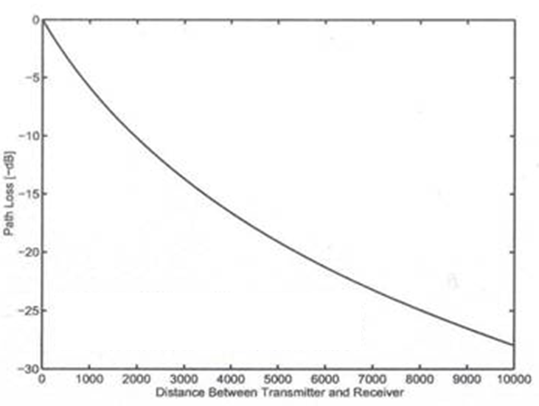
1.6 Chanel Propagation Models
1.6.1 Line of Site or Free Space Path Loss Model
Fig. 1.30 Free space path loss as a function of the distance between transmitter and receiver, d at certain frequency, f.

Slide 11
1.6 Chanel Propagation Models
1.6.1 Line of Site or Free Space Path Loss Model
Example 1.3 For isotropic antennas working at frequency, f = 1.8 GHz, if the received power at a reference distance, d_{o} = 1 km, is equal to P_{r}(d_{o}) = 1 µW, find the received powers at distances, d = 2 km, 5 km, and 20 km from the same transmitter using Free Space Path Loss (FSPL) model.
Solution From Eq.(1.4)
P_{r} (d_{o} = 1 km) = 1 μw f = 1800 MHz G_{tx} = G_{tr} = 0 dBi
FSLP (d km) = 32.4 + 20 log f(MHz) + 20 log d(km).
FSLP (1 km) = 32.4 + 20 log f(1800) + 20log (1) = 97.505 dB
From Eq.(1.3), we have: P_{r}= P_{t} + G_{t} + G_{r} – FSLP
P_{r} (dBw) = 10 log (P_{r} /1) = 10 log (10⁻⁶) = - 60 dBw
- 60 dBw = P_{t} + 0 + 0 – 97.505
P_{t} = P_{r} (dBw) + FSLP = - 60 + (97.505) = 37.505 dBw.
  FSPL (2 km) = 32.4 + 20 log (1800) + 20 log (2) = 103.526 dB.
P_{r} (2 km) = P_{t} – FSPL (2 km) = 37.5 – 103.5 = - 66.02 dBw.
P_{r} (5 km) = P_{t} – FSPL (5 km) = 37.5 – 111.48 = - 73.98 dBw.
P_{r} (10 km) = P_{t} – FSPL( 10 km) = 37.5 – 117.5 = - 80.0 dBw.
P_{r} (20 km) = P_{t} – FSPL (20 km) = 37.5 – 123.7 = - 86.02 dBw.

Slide 12
1.6 Chanel Propagation Models
1.6.2 Mobile Environment Model
Indoor propagation also has reflection, diffraction and scattering effects. It has two major differences with the outdoor models:
- The Transmitter - Receiver distance is much smaller.
- The variability of the environment is large. It varies depending on construction materials, layout, etc
Signal levels and propagation vary with elements such as open/closed doors, antenna mounting locations, etc
Mobile environment model use a close-in distance, d₀ as a known received power reference point.
The power at d₀ may be found using Friis (Free Space) equation or it could be measured. The distance d₀ must be selected to be in the far-field region.
Propagation measurements in a mobile radio channel show that the average received signal strength at any point decays as a power law of the distance of separation between a transmitter and receiver, so the received power at any point at a distance d > d₀ can be obtained using the following equation :
n is called the path loss exponent or environment factor (n = 2 → 6).
(1.6)

Slide 13
1.6 Chanel Propagation Models
1.6.2 Mobile Environment Model
Typical values of n are listed in Table 1.1. Eq. (1.6) is often expressed in dBm as follows:
The distance d₀ is often chosen for low-gain antenna systems to be 1 m in indoor environments and 100 m or 1 km in outdoor environments.
In large coverage cellular systems 1 km reference distances are commonly used.
In microcellular systems smaller distances are used: such as 100 m or 1m.
Table 1.1 Path Loss Exponent for Different Environments
(1.7)
Environment | Path Loss Exponent, n
Free space | 2
Urban area cellular radio | 2.7 to 3.5
Shadowed urban cellular radio | 3 to 5
In building line-of-sight | 1.6 to 1.8
Obstructed in building | 3 to 6
Obstructed in factories | 4 to 6

Slide 14
1.6 Chanel Propagation Models
1.6.2 Mobile Environment Model
Example 1.4
For isotropic antennas working at frequency, f = 1.8 GHz, if the received power at a reference distance, d_{o} = 1 km, is equal to P_{r}(d_{o}) = 1 µW, find the received powers at distances, d = 2 km, 5 km, and 20 km from the same transmitter using Mobile Environment Model for the path loss exponent or environment factor: a) n = 3 and b) n = 4.
Solution Pr (d_{o} = 1 km) = 1 μw f = 1800 MHz G_{tx} = G_{tr} = 0 dBi
P_{t} = 37.505 dBw. From Eq.(1.4), we have:
a) For n = 3:
P_{r} (2 km) = 10 log (10⁻⁶) – 30 log (2) = - 69.03 dBw.
P_{r} (5 km) = 10 log (10⁻⁶) – 30log (5) = - 80.9 dBw.
P_{r} (10 km) = 10 log (10⁻⁶) – 30log (10) = - 90 dBw.
P_{r} (20 km) = 10l og (10⁻⁶) – 30log (20) = - 99.03 dBw
For n = 4:
P_{r} (2 km) = 10 log (10⁻⁶) – 40log (2) = - 72.04 dBw
P_{r} (5 km) = 10 log (10⁻⁶) – 40log (5) = - 87.95 dBw.
P_{r} (10 km) = 10 log (10⁻⁶) – 40log (10) = - 100 dBw.
P_{r} (20 km) = 10 log (10⁻⁶) – 40log (20) = - 112.04 dBw.

Slide 15
1.6 Chanel Propagation Models
1.6.3 Empirical Models
1.6.3.1 Okumura - Hata Model
The Okumura–Hata model is one of the most widely used empirical propagation models for predicting the path loss in mobile wireless communication systems. It is based on extensive measurements by Okumura in Tokyo (1960s), later approximated by Hata (1980s) into mathematical formulas.
For Urban: the median path loss L₅₀ or L_{p} (in dB) is given by:
L₅₀= L_{p}= 69.55+26.16 log (f_{c})-13.82 log (h_{te})- a(h_{ra}) + [44.9 - 6.55 log (h_{ta})] log(d)
Where:
- f_{c} = frequency (MHz), valid 150–1500 MHz (extended to 2 GHz in COST-231 model).
- h_{ta} = transmitter antenna height (30–200 m).
- h_{ra} = receiver antenna height (1–10 m).
- d = distance between transmitter and receiver (1–20 km).
- a(h_{ra}) = correction factor for receiver antenna height
(1.8a)

Slide 16
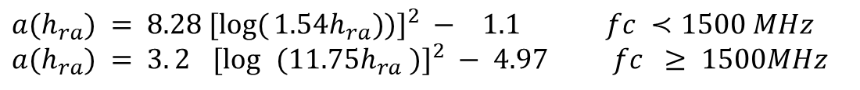
1.6 Chanel Propagation Models
1.6.3 Empirical Models
1.6.3.1 Okumura - Hata Model
Correction Factor a(h_{re})
For small/medium cities:
For large cities:
Environment Variants
1. Urban areas: use main formula.
2. Suburban areas:
3. Open rural areas:
Where K ranges from 35.94 (countryside) to 40.94 (desert).
Limitations: - Frequency range: 150–1500 MHz (extended to 2000 MHz with COST-231) - Distance: 1–20 km - Valid for macro-cellular environments, not suitable for indoor or micro-cells - Based on measurements in Tokyo → may not generalize to all regions.
$$a(h_{ra}) = \text{[}\text{1.1 log }(f_{c} )\text{ − 0.7})]h_{ra}\text{− }[\text{1.56 log }(f_{c})\text{ −0.8})] \text{dB}$$
(1.8b)
$$a(h_{ra}) = 8.28 [\log{(}1.54h_{ra}))]^{2} −_{}1.1 fc ≺1500 MHz \\ a(h_{ra}) = 3.2_{}[\log{ }(11.75h_{ra} )]^{2} − 4.97 fc ≥ 1500MHz$$
(1.8c)
(1.8d)
(1.9)

Slide 17
1.6 Chanel Propagation Models
1.6.3 Empirical Models
1.6.3.2 Hata - Cost
The Hata–COST 231 model is an extension of the Okumura–Hata model, developed within the European COST-231 project to improve the estimation of path loss in mobile communication systems operating at higher frequencies. It is widely used for GSM 1800, UMTS 2100, and early 4G system planning.
General Path Loss Formula
L_{p} = L₅₀= 46.3+33.9 log (f_{c})-13.82 log(h_{ta}) - a(h_{ra})+[ 44.9-6.55 log(h_{ta})] log(d)+C_{M}
Where:
- f_{c}: frequency in MHz (1500 – 2000 MHz).
- h_{ta}: effective base station antenna height (30 – 200 m).
- h_{ra}: effective mobile antenna height (1 – 10 m).
- d: distance between transmitter and receiver (1 – 20 km).
- a(h_{ra}): mobile antenna height correction factor.
- C_{m}: environment factor = 0 dB for medium-sized city and suburban areas, 3 dB for metropolitan centers.
(1.10)

Slide 18
1.6 Chanel Propagation Models
1.6.3 Empirical Models
1.6.3.2 Hata - Cost
Mobile Antenna Height Correction Factor
For small/medium cities, use Eq. (1.8b).
For large cities: use Eq.(1.8c) and Eq.(1.8d).
Applicability
Okumura - Hata model standard frequency range: 150 – 1500 MHz.
Hata – Cost model extends to 2000 MHz.
Using Hata – Cost model formulas outside these ranges gives approximate results; use with caution.
Both modes are suitable for urban and suburban environments.

Slide 19
1.6 Chanel Propagation Models
1.6.3 Empirical Models Summary
Empirical Modes formulae can be summarized in Table 1.2.
Table 1.2 formulae for different Empirical Modes
Area | Okumura-Hata Model |  | Hata - COST Model
Urban | L₅₀ = 69.55 + 26.16 log (f_{c}) - 13.82 log (h_{ta}) – a (h_{ra}) + [44.9 - 6.55 log (h_{ta})] log (d) |  | L₅₀ = 46.3 + 33.9 log (f_{c}) - 13.82 log (h_{ta}) - a (h_{ra}) + [44.9 - 6.55 log (h_{ta})] log (d) + C_{M}
Small, downtown, and Medium City |  | a (h_{ra}) = (1.11 log (f_{c}) - 0.7) h_{ra} - (1.56 log (f_{c}) - 0.8) dB
Large City |  | a (h_{ra}) = 8.29 (log1.54h_{ra})² - 1.1dB for f_{c}<= 1500MHz a (h_{ra}) = 3.2 (log11.75h_{ra})² - 4.97dB for f_{c} => 1500MHz
Sub-Urban |  | L₅₀(dB) = L₅₀(Urban) – 2 [log(f_{c}/28)]² - 5.4
Open and rural area |  | L₅₀(dB) = L₅₀(Urban) - 4.78 [log (f_{c})]² + 18.33 log (f_{c}) - 40.94
C_{M} for Hata – COST Model |  | C_{M} = 0 dB for Medium and Sub-Urban, C_{M} = 3 dB for metropolitan centers and downtown

Slide 20
1.6 Chanel Propagation Models
1.6.3 Empirical Models
Example 1.5
For isotropic antennas working at frequency, f = 1.8 GHz, if the received power at a reference distance, d_{o} = 1 km, is equal to P_{r}(d_{o}) = 1 µW, find the received powers at distances, d = 2 km, 5 km, and 20 km from the same transmitter using Mobile Environment Model for Hata-Cost model for a large city environment if the height of transmitter antenna, h_{ta} = 40 m and the height of receiver antenna above plane when an h_{ra} = 3 m.
Solution P_{r} (d_{o} = 1 km) = 1 μw f = 1800 MHz G_{tx} = G_{tr} = 0 dBi
P_{t} = 37.505 dBw. From Eq.(1.10), we have:
L₅₀ (Urban) = 46.3 + 33.9 log (f MHz) – 13.82 log (h_{t}) – a( h_{r})
+ [44.9 – 6.55 log (h_{t})] log(d) + C_{M}
C_{M} = 3 dB.
a(h_{ra}) = 3.2 [Log (11.75 h_{ra})]² – 4.97 dB = 2.68 dB.
P_{r} (d) = P_{t} + G_{t} + G_{r} – L₅₀ = 37.5 - L₅₀.
L₅₀(2 km) = 142.185 dB and P_{r} (2 km) = - 104.69 dBw.
L₅₀ (5 km) = 155.87 dB and P_{r} (5 km) = - 118.37 dBw.
L₅₀ (10 km) = 166.23 dB and P_{r} (10 km) = -128.73 dBw.
L₅₀ (20 km) = 176.58 dB and P_{r} (20 km) = -139.08 dBw.

Slide 21
1.6 Chanel Propagation Models
1.6.4 Statistical (Minimum Mean Square Error) Model
Long distance path loss model does not consider the fact the surrounding environment may be vastly different at two locations having the same Tx-Rx separation.
This leads to measurements that are different than the predicted values obtained using the above equation.
Measurements show that for any value d, the path loss L_{P}(d) in dB at a particular location is random and distributed normally.
The log-normal shadowing model indicates the received power at a distance d is normally distributed with a distance dependent mean and with a standard deviation of σ.
In practice the values of n and σ are computed from measured data using linear regression so that the difference between the measured data and estimated path losses are minimized in a Mean Square Error (MSE) sense.
We would like to find a value of n that will minimize the mean square error E(n) value. This can be achieved by writing MSE as a function of n. Then finding the value of n which minimizes this function. This can be done by derivative of E(n) with respect to n and solving for n which makes the derivative equal to zero.

Slide 22
1.6 Chanel Propagation Models
1.6.4 Statistical (Minimum Mean Square Error) Model
Let k be the received power measurements that are taken at distances of d₁, d₂, d₃ …. and d_{K} from a transmitter. The measured power values at these distances are: P_{m1}, P_{m2}, P_{m3} … and P_{mk}, respectively.
It is assumed that the path loss for these measurements follows the log-normal model, so the received power at distance, d is P_{r}(d) that has the form:
In dBm form it is expressed as:
So the received power at distance, d_{i} is given by:
Then
(1.12a)
(1.12b)
(1.12c)
(1.12d)

Slide 23
1.6 Chanel Propagation Models
1.6.4 Statistical (Minimum Mean Square Error) Model
The Squared Error, E(n) is defined by:
For Minimum Squared Error (MSE) we have:
Solve (1.12) for n, we get:
(1.13a)
(1.13b)
(1.14)
(1.15)

Slide 24
1.6 Chanel Propagation Models
1.6.4 Statistical (Minimum Mean Square Error) Model
Example 1.6
Four received power measurements were taken at distances d₁ = 100 m, d₂ = 200 m, d₃ = 1 km, and d₄ = 2 km from a transmitter. The measured values at these distances are: P_{m1} = 0 dBm, P_{m2} = -25 dBm, P_{m3} = -35 dBm, and P_{m4} = -39 dBm, respectively. It is assumed that the path loss for these measurements follows the log-normal model where d_{o} = 100 m.
a) Find the Mean Square Error (MSE) estimate for the path loss exponent n.
b) Estimate the received power at d = 4 km using the resulting model.
Solution
a) Apply Eq. (1.15) for k = 4, we get:

Slide 25
1.6 Chanel Propagation Models
1.6.4 Statistical (Minimum Mean Square Error) Model
Example 1.7 Solution
b) the received power at d = 4 km is calculated using Eq. (1.12), we get:

Slide 26
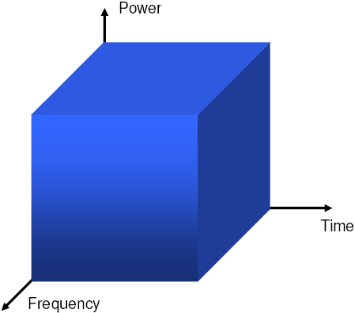
1.2 General Wireless Communication Background
1.2.2 Multiple Access Techniques
We Have resources (frequency, time and power) as shown in Fig. 1.5 so How these resources can be assigned or divided between users?.
Fig. 1.5 Power as function of time and frequency.

Slide 27
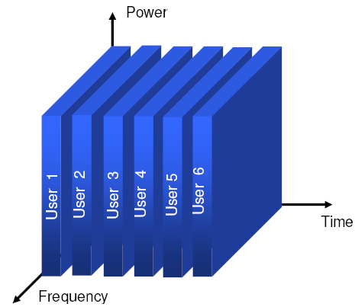
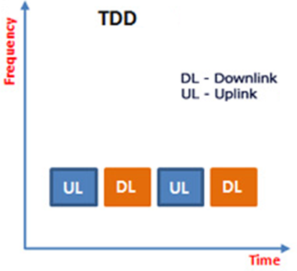
1.2 General Wireless Communication Background
1.2.2 Multiple Access Techniques
1. Time Division Multiple Access (TDMA) [Refer to Fig. 1.6]
Each user gets a time slot where he can use all the frequency with high power as shown in Fig. 1.6.
Multiple access mode
Fig. 1.6 Time division multiple access.

Slide 28
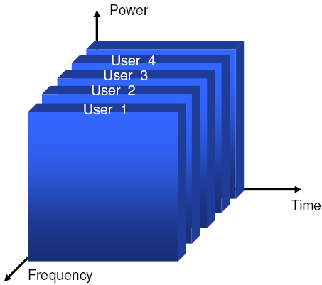
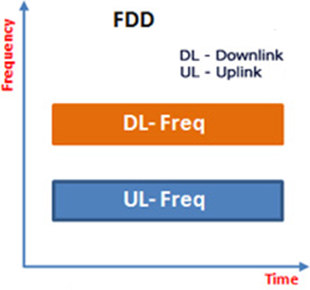
1.2 General Wireless Communication Background
1.2.2 Multiple Access Techniques
2. Frequency Division Multiple Access (FDMA) [Refer to Fig. 1.7]
Each user gets a frequency slot that he can use all the time with high power as shown in Fig. 1.7.
Multiple access mode
Fig. 1.7 Frequency division multiple access.

Slide 29
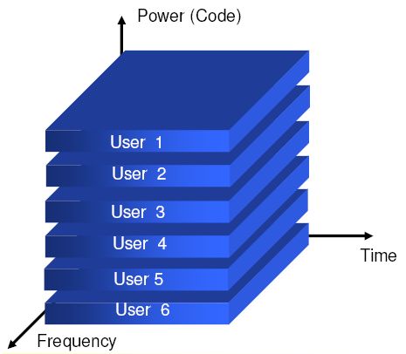
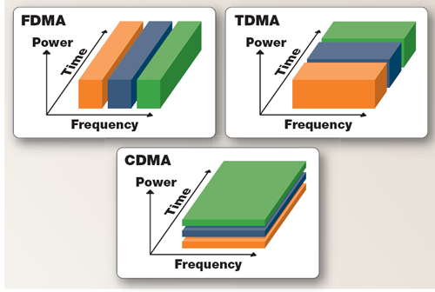
1.2 General Wireless Communication Background
1.2.2 Multiple Access Techniques
3. Code Division Multiple Access (CDMA) [Refer to Fig. 1.8]
A user gets all the time and uses all the frequency range but uses only a part of the power (through the use of codes) as shown in Fig. 1.8.
Multiple access mode
Fig. 1.8 Code Division Multiple Access.

Slide 30
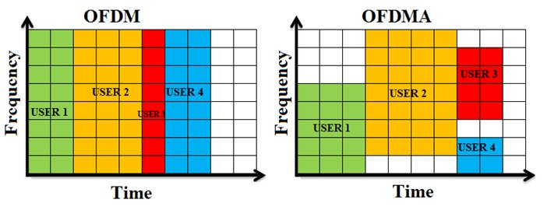
1.2 General Wireless Communication Background
1.2.2 Multiple Access Techniques
4. Orthogonal Frequency Division Multiple Access (OFDMA) [Refer to Fig. 1.9]
OFDM (Orthogonal Frequency Division Multiplexing) and OFDMA (Orthogonal Frequency Division Multiple Access) are both wideband digital communication technologies with a slight difference between them. However, both are based on the same concept of bundling evenly spaced multiple sub-carriers with special characteristics into one big chunk and still transmitting separately over the transmission media. However, when it comes to providing simultaneous multi-user access, two technologies have a significant difference in channel as shown in Fig. 1.9.
Fig. 1.9 Orthogonal Frequency Division Multiple Access.

Slide 31
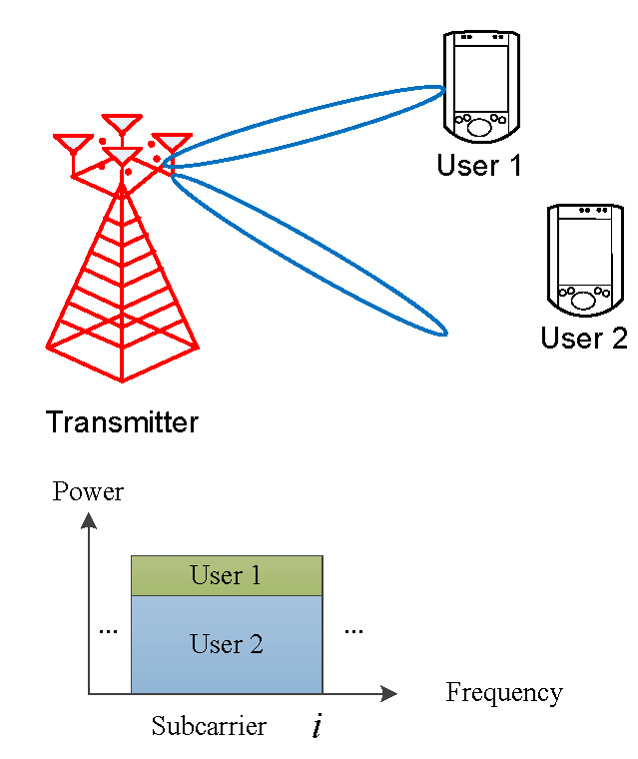
1.2 General Wireless Communication Background
1.2.2 Multiple Access Techniques
5. Non Orthogonal Multiple Access Technique (NOMA) [Fig. 1.10]
NOMA is via power domain multiplexing as shown in Fig. 1.10).
Fig. 1.10 Non Orthogonal Multiple Access Technique (NOMA).
.

Slide 32
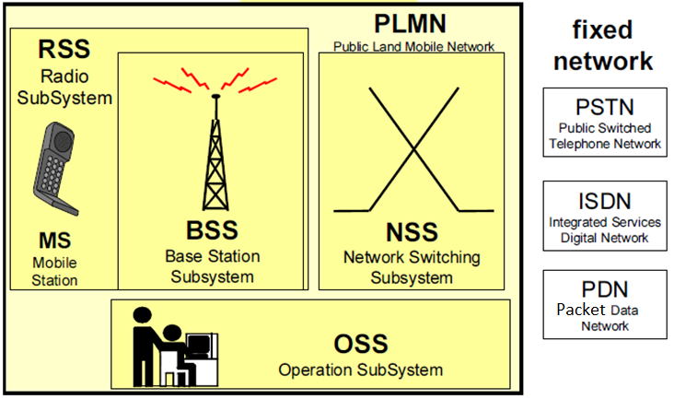
2.1 Mobile system network Architecture
2.1.1 Mobile Network Structure
The mobile system, as shown in Fig. 2.1(a) consists of three basic subsystems that can be distinguished as:
Radio Sub-System (RSS) which includes the Mobile Station (MS), Base Transceiver Station (BTS) and Base Station Controller (BSC).
Network Switching Sub-System (NSS).
Operation Sub-System(OSS).
NSS and OSS are defined as the Core Network (CN)
Fig. 2.1(a) Block diagram of mobile system network architecture.

Slide 33
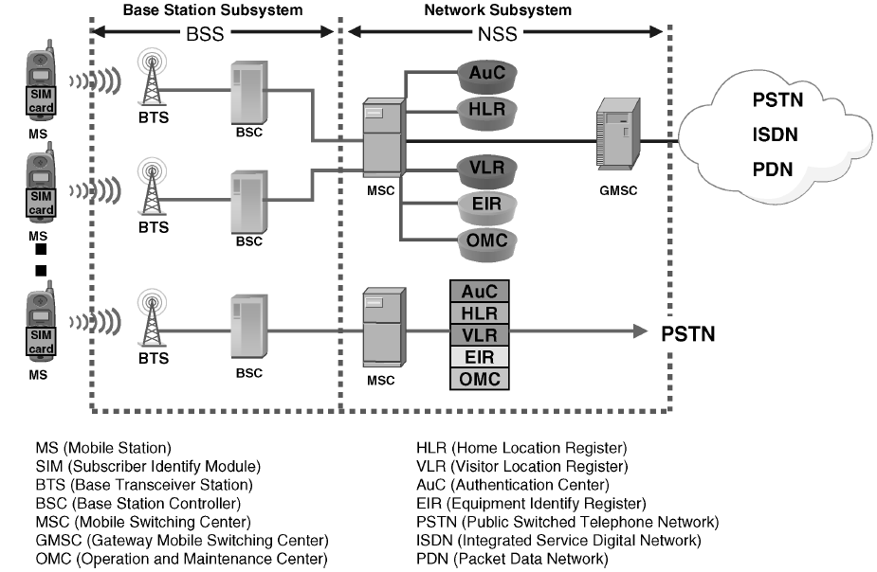
2.1 Mobile system network Architecture
2.1.1 Mobile Network Structure
Fig. 2.1(b) Detailed mobile system network architecture.

Slide 34
2.1 Mobile system network Architecture
2.1.1 Mobile Network Structure
The three basic subsystems can be distinguished as:
Radio Sub-System (RSS): The Radio Sub-System RSS consists of the Mobile Stations MS and the Base Station Subsystem BSS, which is composed of the following functional units:
    Base Transceiver Station (BTS)
    Base Station Controller (BSC)
Network Switching Subsystem (NSS): consists of the following functional units:
    Mobile Switching Center (MSC)
    Gateway Mobile Switching Center (GMSC)
    Home Location Register (HLR)
    Visitor Location Register (VLR)
    Authentication Center (AUC or AC)
    Equipment Identity Register(EIR)
Operation Sub-System (OSS): consists of Operation & Maintenance Centers (OMCs).
NSS and OSS are defined as the Core Network (CN).

Slide 35
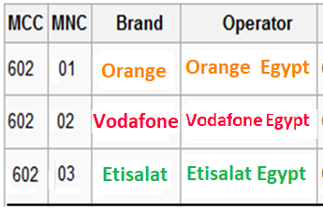
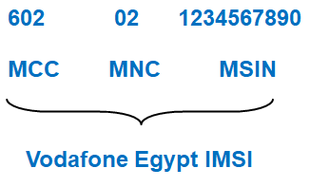
2.1 Mobile system network Architecture
2.1.1 Mobile Network Structure
Notes:
The Mobile Station is the interface between the user and the network. The MS consists of two independent parts: Mobile Equipment (ME) and Subscriber Identity Module (SIM) card.
Each ME is assigned to a unique hardware identification called the International Mobile Equipment Identity (IMEI) which enables the network operator to identify mobile equipment which may be causing problems on the system and is stored in Equipment Identity Register (EIR).
Each SIM card has a unique identification number called the International Mobile Subscriber Identity (IMSI).The IMSI which uniquely identifies a subscriber in a mobile network consists of three fields [Mobile Country Codes, MCC (3 digits), Mobile Network Code, MNC (2 digits ) and Mobile Subscriber Identification Number, MSIN (11 digits)]:
Example
Country | MCC
Germany | 262
Egypt | 602
Canada | 302
UAE | 424

Slide 36
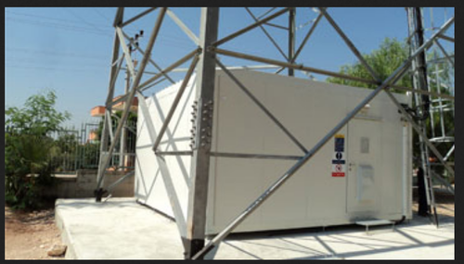
2.1 Mobile system network Architecture
2.1.2 Mobile Communication Site
Cell Site
It consists of all equipment (antenna, building and ground) used to transmit cell signals to and from the mobile device back to the receiver. Typically, It includes Transmitter/Receivers station (BTS), GPS, backup power sources, backhaul connections, and more.
Equipment shelter manufacturers offer a diverse selection of buildings to provide a safe and secure structure for sensitive telecommunications equipment.

Slide 37
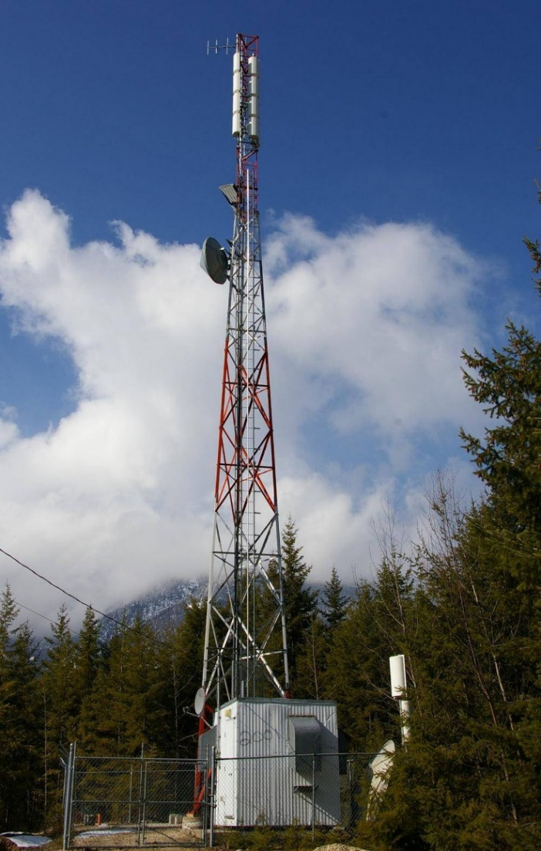
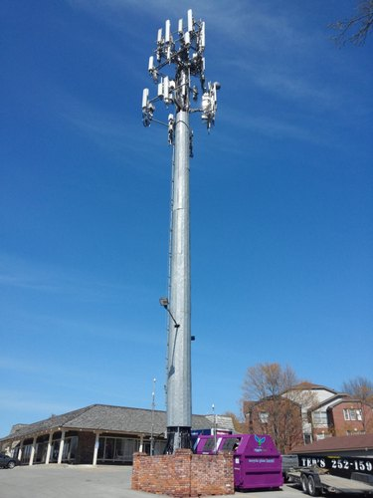
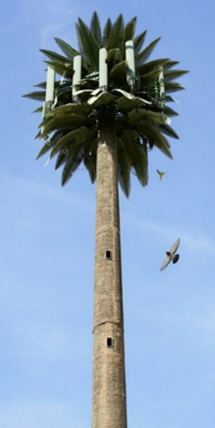
2.1 Mobile system network Architecture
2.1.2 Mobile Communication Site
Types of Cell Tower
Green Field Tower
Self Support Monopole Tower
Palm Tree Tower

Slide 38
2.1 Mobile system network Architecture
2.1.3 Mobile Industry Companies
Mobile industry includes the following companies:
1. Operators:
A mobile phone operator, wireless, Internet or carrier provider is a mobile telecommunications company that provides wireless voice and Internet services for mobile device users.
The operator gives a Subscriber Identity Module (SIM) card to the customer who inserts it into the mobile device to gain access to the services.
Currently, there are 4 companies in Egypt which offer cellular communication service: Orange, Vodafone, Etisalat, and WE (by Telecom Egypt).
These companies also provide services surpassing voice communication, such as 2G, 3G, 4G and mobile internet.
2. Vendors
Vendors of Network equipment providers are companies that sell product and services to communication service providers such as fixed or mobile operators as well as to enterprise customers.
Some Vendor providers in each customer segment are:
- Alcatel-Lucent - Ericsson - Huawei - Samsung
- TP-Link - D-Link - Juniper Networks - NEC
- Nokia Networks - Ciena - ZTE

Slide 39
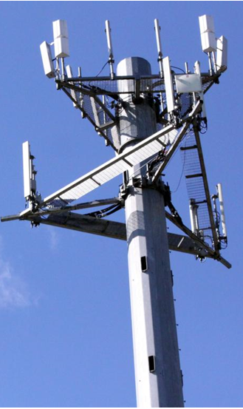
2.1 Mobile system network Architecture
2.1.3 Mobile Companies
3. Contractors and Sub- Contractors:
They provide engineering, design, construction, and maintenance services for wireline and wireless communications, including:
- Cell tower construction
- Broadband fiber optic cable installation
- Wireline construction
- Emergency maintenance services
They combine cutting-edge technology, innovative solutions, skilled professionals, and an unfailing commitment to safety to ensure that the companies are able to meet their customers’ communication needs with the highest levels of reliability and quality.
Fig. 2.2 Cell tower.

Slide 40
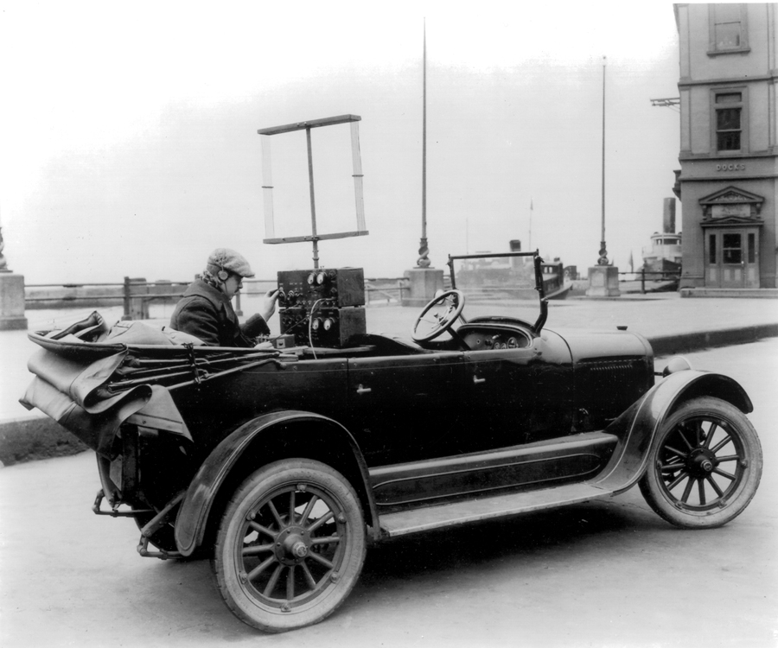
2.4 Mobile Network History and Generations
1960 Early Mobile or Zero Generation (0G) Mobile system
In 1960 a car Mobile Telephone version A (MTA) system was launched in Sweden which was composed of vacuum tubes and relays and weight of 40 kg. The Weight was reduced in the subsequent versions (MTB and MTD) by using transistors.
The radio telephone system contained:
  - One central antenna tower per region.
  - Radio phones have a powerful transmitter, capable of transmitting up to 50 miles which affect the public health.
  - The number of radio telephones per region was limited by the number of available channels.
  - Radio telephones are typically mounted in cars, trucks, and briefcases.

Slide 41
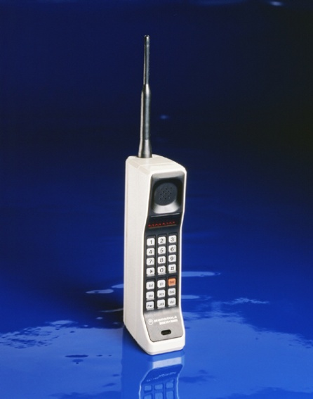
2.4 Mobile Network History and Generations (Continued)
1979 First Generation (1G) Mobile system
Martin Cooper, a Motorola researcher is considered to be the inventor of the first practical mobile phone for hand-held use.
The first commercially automated cellular network was launched in Japan by NTT in 1979.
Nordic Mobile Telephony (NMT) started cellular operations in Europe.
Total Access Communication System (TACS) started in UK.
In America Advanced Mobile Phone Service (AMPS) was developed, the first generation(1G) that had the following specifications:
Use cellular concept to provide service to a geographic area
Designed for voice communications using analog signals.
Use FDMA to divide each 25-MHz band into 30-kHz channels.
Operates in the 800-MHz range. Uses two separate bands:
forward or downlink BS → MS (869 –894 MHz) and reverse
or uplink MS → BS (824 –849 MHz). Each band is divided
into 832 channels, 790 for communications & 42 for control.
Analog voice channels are modulated using FM and digital
control channels use FSK to create 30 kHz analog signals.
- They were based on different standards so incompatible,
with each other, limited capacity and did not support roaming.

Slide 42
2.4 Mobile Network History and Generations (Continued)
1982-1992 Second Generation (2G) Mobile system
in 1982 the Conference of European Postal and Telecommunications (CEPT) administrations created a group to develop a standard for a mobile telephone system, Global System for Mobile (GSM), that would operate in the 900 MHz bandwidth.
In 1983 (Digital AMPS) D-AMPS was lunched in USA. Cellular Digital Packet Data (CDPD) is a packet-switched data service. CDPD uses the existing AMPS network to transmit data at a rate of 19.2 kb/s.
In 1990, a group of 15 Vendors from across Europe implemented GSM 900.
The first commercial GSM network was launched in June, 1992 in Germany.
TDMA IS-136, Personal Digital Cellular (PDC) and Personal Handy Phone System (PHS) are examples of GSM.
The second generation (2G) or GSM has the following specifications:
Use digital technology and apply cellular concept and circuit switching.
Frequency band (900, 1800, 1900 MHz) and support international roaming.
FDMA - TDMA/FDD accessing technique (8 time slot/carrier) → (Limited capacity).
Voice rates have 2 types full rate 13 kb/s and half rate 6.5 kb/s.
  Application (Voice, SMS, Data) → (Limited number of services).
  Limited data rate = 9.6 kbps → (Low).

Slide 43
2.4 Mobile Network History and Generations (Continued)
1993 Second Generation (2G) Mobile system
2G uses circuit-switched data modems. This limits data rates to those of voice communication.
In 1993 Code Division Multiple Access (CDMA) is a second-generation digital cellular telephone system that was first deployed.
- CDMA IS-95A provides data rate up to 9.6 kb/s/14.4 kbps.
1994-1998 Second Generation (2.x G) Mobile system
To support the wide-spread use of internet applications on mobiles, 2.5G also supports Wireless Applications Protocol (WAP), which allows standard web pages to be viewed in a compressed format.
Enabling location-based mobile service
TDMA
  - High Speed Circuit Switched Data (HSCSD) for 2.5G GSM. HSCSD increases the available application data rate to 14.4 kbps, as compared to the original 9.6 kbps per time slot in the GSM specification.
  - Using up to 8 consecutive time slots achieves raw transmission rate of up to 115.2 kbps
  - General Packet Radio Service (GPRS) for 2.5G GSM and IS-136.

Slide 44
2.4 Mobile Network History and Generations (Continued)
1994-1998 Second Generation (2.xG) Mobile system
GPRS increases the available application data rate to 21.4 kb/s per slot, when using all 8 time slots of a GSM channel, GPRS achieves a data rate of 171.2 kb/s.
Implementation of GPRS merely requires the GSM operator to install new routers, internet gateways at the BS, and new SW that redefines the BS air interface standard for GPRS.
GPRS was also extended to include the IS-136 TDMA standard.
Enhance Data rate for GSM Evolution (EDGE) is sometimes referred to as Enhanced GPRS, or EGPRS. Requires the addition of new HW and SW at existing BSs. It introduces a new digital modulation format, 8-bit Phase Shift Keying (8-PSK), which is used in addition to GSM’s standard Gaussian Minimum Shift Keying (GMSK) modulation.
EDGE Enhanced Data Rates for GSM Evolution (EDGE) for 2.5G GSM and IS-136.
In this technology 8-PSK modulation + 8 time slots ➔ a raw peak throughput data rate of 547.2 kb/s. Practically, only 384 kb/s can be achieved for a single user.
CDMA CDMA IS-95B provides data rate up to 115.2 kb/s which is categorized as 2.5 G.

Slide 45
2.4 Mobile Network History and Generations (Continued)
1994-1998 Second Generation (2.xG) Mobile system
Effects of GPRS and EDGE
EDGE
Enhanced Data rates for GSM Evolution.
2.75G.
Data rates varies from 59.2.4 kb/s for one time slot to theoretical 473.6 kb/s but practically 384 kb/s for 8 times lots.
Packet switching
Using new Modulation scheme (8-PSK)
Evolved EDGE continues up to 1 Mb/s
HSCSD
High Speed Circuit Switched Data
2.5G.
Data rates varies from14.4 kb/s for one time slot to 115.2 kb/s for 8 time slots.
Circuit switching Technology.
GPRS
General Packet Radio Service
2.5G.
Data rates varies from 21.4 kb/s for one time slot to 171.2 kb/s for 8 time slots.
Packet switching such as an Internet connection.
Variable coding schemes.

Slide 46
2.4 Mobile Network History and Generations (Continued)
1999 Third Generation (3G) Mobile system
The third-generation cellular networks were developed with the aim of offering high speed data and multimedia connectivity to subscribers.
The International Telecommunication Union (ITU) under the initiative International Mobile Telecommunication (IMT-2000) has defined 3G system as being capable of supporting high speed data ranges from 144 kb/s to greater than 2 Mb/s.
The 3G evolution for CDMA systems leads to CDMA2000, which is based on the IS-95 and IS-95B technologies
The 3G evolution for GSM and IS-136 systems leads to Wideband CDMA (W-CDMA), also called Universal Mobile Telecommunications System (UMTS) and that has the following specifications:
Large network capacity.
Voice Over Internet Protocol (VOIP).
Multimedia communications.
Circuit-switched and packet-switched-based services.
Improved spectral efficiency.
Global roaming.
“always-on” packet-based air interface ➔ users share the same wireless network and stay connected to the Internet, anytime, anywhere.

Slide 47
2.4 Mobile Network History and Generations (Continued)
2005 Third Generation (3.xG) Mobile system
High-Speed Packet Access (HSPA)
High-Speed Downlink Packet Access (HSDPA) is an enhanced 3G also dubbed 3.5G. It supports data rate of 14.0 Mb/s
High-Speed Uplink Packet Access (HSUPA) enhances the uplink rate to 5.76 Mb/s known as 3.75G.
HSPA+ supports MIMO which increase rate to 42 Mb/s.
2006 - 2020 Fourth Generation (4G) Mobile system (LTE)
Long term Evolution (LTE) is actually a 3.9G technology.
The Worldwide Interoperability for Microwave Access (WiMAX) is a form of LTE.
LTE has the following specifications :
Large network capacity.
Downlink peak rates of at least 100 Mbps.
An uplink of at least 50 Mbps.
Video conferencing.
Voice Over IP (VOIP).
Greater mobility and low cost.

Slide 48
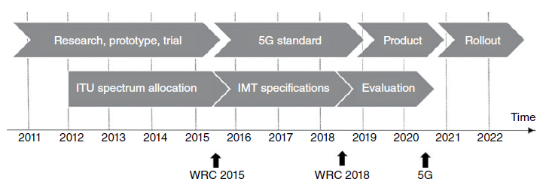
2.4 Mobile Network History and Generations (Continued)
2021 - Up Fifth Generation (5G) Mobile system
The increasing number of connected devices imposes another challenge on the future mobile network. Everyone and everything will be inter‐connected – under the umbrella of Internet of Everything (IoE) – where tens to hundreds of devices will serve every person.
Mobile communications will play a pivotal role in enabling efficient and safe transportation by allowing vehicles to communicate with each other.
Data rate from 1 Gbps to 10 Gbps

Slide 49
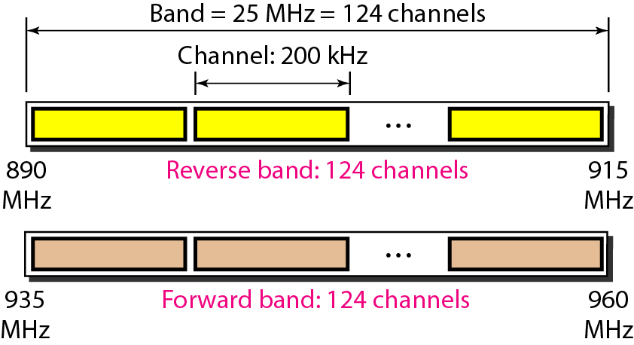
1.3 Number of Users in a Cellular System (System Capacity)
Application of FDMA and TDMA in the Second Generation (2G) Mobile
In 900 MHz band: 890-915 MHz Uplink band, 935-960 MHz Downlink.
Radio carrier is a 200kHz channel => 124 pairs of radio channels in addition to guard bands can be used as shown in Fig. 1.24.
Fig. 1.18 European standard GSM specifications.

Slide 50
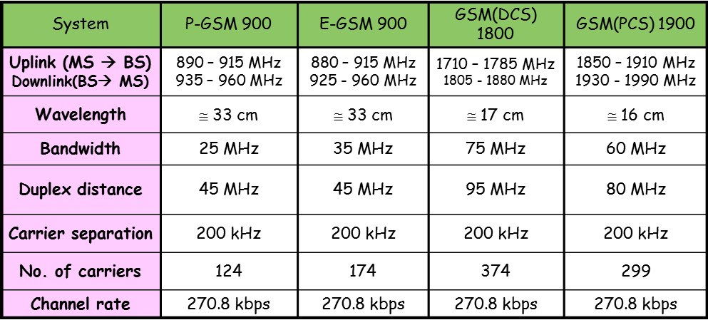
1.3 Number of Users in a Cellular System (System Capacity)
Application of FDMA and TDMA in the Second Generation (2G) Mobile
Table 1.1 shows the frequency bandwidths adopted in the GSM 900 and 1800 MHz systems for the uplink (from the mobile station to the base station) and for the downlink direction (from the base station to the mobile station).
Full duplex transmission in both bandwidths is carried out based on separate frequency ranges. Each of the bands is divided into channels with a bandwidth of 200 KHz.
Table 1.1 Frequency range and the number of available channels for the GS

Slide 51
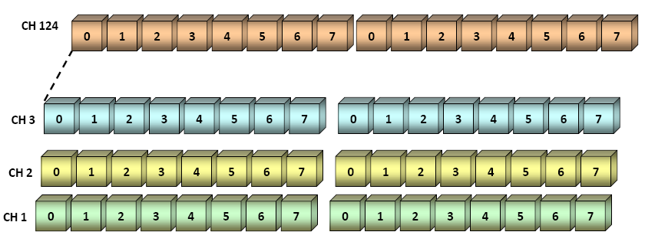
1.3 Number of Users in a Cellular System (System Capacity)
Application of FDMA and TDMA in the Second Generation (2G) Mobile
Users are given time slots in a narrowband channel (8 users). Multiple access is orthogonal, This means that users within the cell never interfere with each other channel, as in Fig. 1.25.
Fig. 1.19 FDMA and TDMA in GSM system channels.

Slide 52
1.3 Number of Users in a Cellular System (System Capacity)
Application of FDMA and TDMA in the Second Generation (2G) Mobile
For a mobile network, given the following:
- The total number of duplex channels in the network is N_{chnet} .
- The number of cells in a cluster is N.
- The Number of channels per cluster, N_{chcls} = N_{chnet} .
- Number of channels per cell = N_{chcell} = N_{chcls} / N .
- If a cluster is replicated N_{cls} times within the system, then the total number of duplex channels, N_{chtotal} is given by:
N_{chtotal} = (N_{chnet}) x N_{cls} = (N_{chcls}) x N_{cls} [Channels]
Example 1.1 (Typical GSM network)
Up link: 890 - 915 MHz , Down link: 935 - 960 MHz → BW = 25 MHz
BW of each user channel, BW_{ch} = 200 kHz and cluster sizes, N = 7.
Total number of channels, N_{chnet} = 25/0.2=125 channel=124 channel (+Guard B).
Number of channels per cell = N_{chcell} = N_{chcls} / N = 124/7 = 17.7 channel (17 channels). Each channel is divided into 8 time slots (TDMA).
Number of users per cell (Cell Capacity) = 17 x 8 = 136 (simultaneous users).
Number of users per cluster (Cluster Capacity) = 7 x 136 = 952 simultaneous user.
For 2000 cluster, the number of simultaneous = 2000 x 952 = 1,904,000 user

Slide 53
1.3 Number of Users in a Cellular System (System Capacity)
Frequency Planning in the Second Generation (2G) Mobile
Example 1.2 (Mobile system)
A mobile service area of 15 x 10 km need to be covered, the cluster size N may be 3 or 7, cell radius is R = 0.8 km. Compute the number of simultaneous users in this network (Network Capacity), given that the total number of RF channels, N_{chnet} = 750 channel and each channel is divided into 8 time slots (TDMA). Note that the cell area for hexagonal, A_{cell} = 2.5981 x R².
Solution: Service area, Area_{sev} =15 x 10 = 150 km²
Cell area A_{cell} = 2.5981 x R² = 2.5981 x (0.8)² = 1.6628 km²
For N=3
Cluster area = N x Cell area = 3 x 1.6628 = 4.9884 km²
# of clusters in the service area, N_{cls} =150 / 4.9884 = 30.0698 ≈ 30 cluster.
# of channels per cluster, N_{chcls} = N_{chnet} = 750 channel.
# of channels per cell, N_{chcell}= 750 / 3 = 250 channel.
# of simultaneous users per cell (Cell Capacity), N_{uscell} = 250 x 8 = 2000 user.
# of simultaneous users for the mobile system (System Capacity), in the service area: N_{usnet} = 750 x 8 x 30 = 0.18 million user
For N=7 Cluster area = 7 x Cell area = 7 x 1.6628) =11.6396 km²
# clusters in the area = N_{cls} =150 / 11.6396 = 12.8870 ≈ 13 cluster.
# users per cell (Cell Capacity), N_{uscell} = (750 / 7) x 8 = 285 user.
# users per mobile system in the service area, N_{usnet} =750x8x13 =78,000 user.

